Slide 1
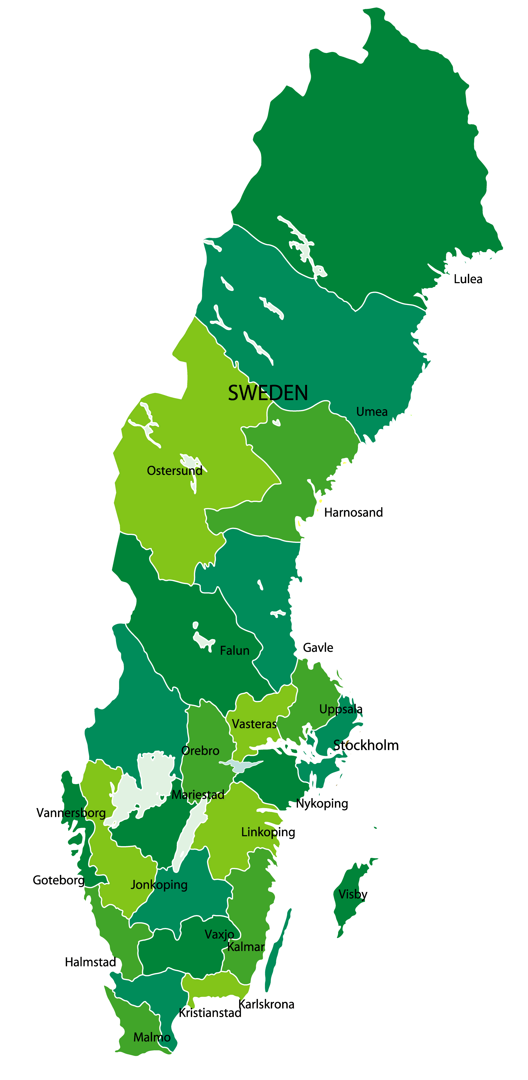
SINIC - The Swedish Interdisciplinary, and Interprofessional Network in Person-centred and Integrated Care
National
Main Goal
To increase collaboration in the field of integrated care between researchers in Sweden, and provide a unique interdisciplinary and interprofessional national environment and network that will result in pioneering science
> 50 Doctoral students and their supervisors
Disciplines
biomedicine
health education medicine
nursing
occupational therapy
physiotherapy
psychology
public health
social work
technology
Close collaboration
Network activities
with universities healthcare organizations, social services and society
Yearly meetings
Junior researchers Career development
Increase the interdisciplinary research funding

